Slide 1

CSIS-210 Data Structures: RECURSION
Lecture 11, Fall 2016
No lab this week ☺
Project 2: Assigned today. Due 11/14 at start of class.

Slide 2
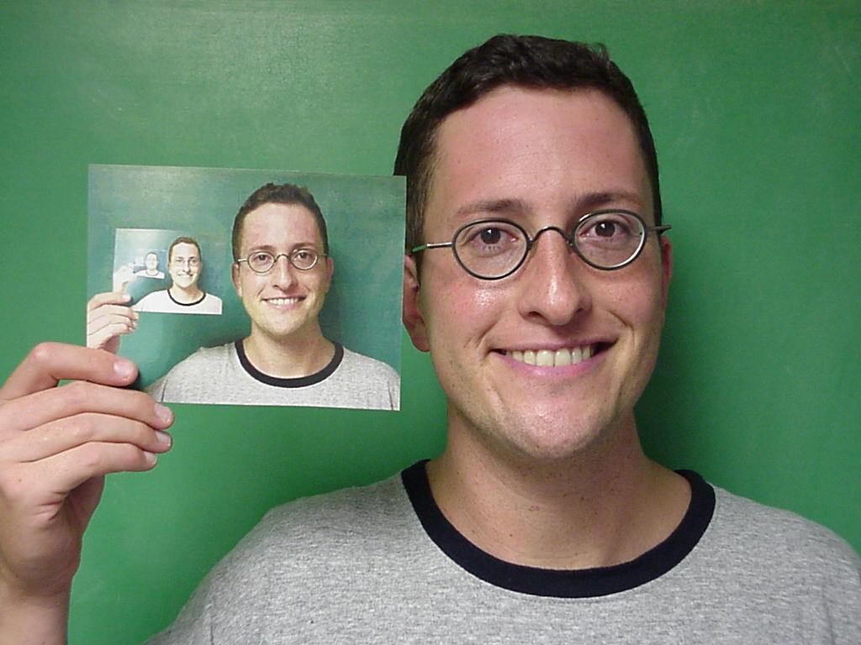
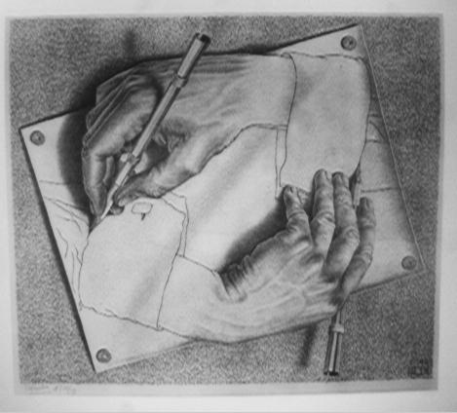

Slide 3
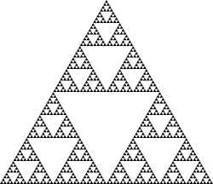
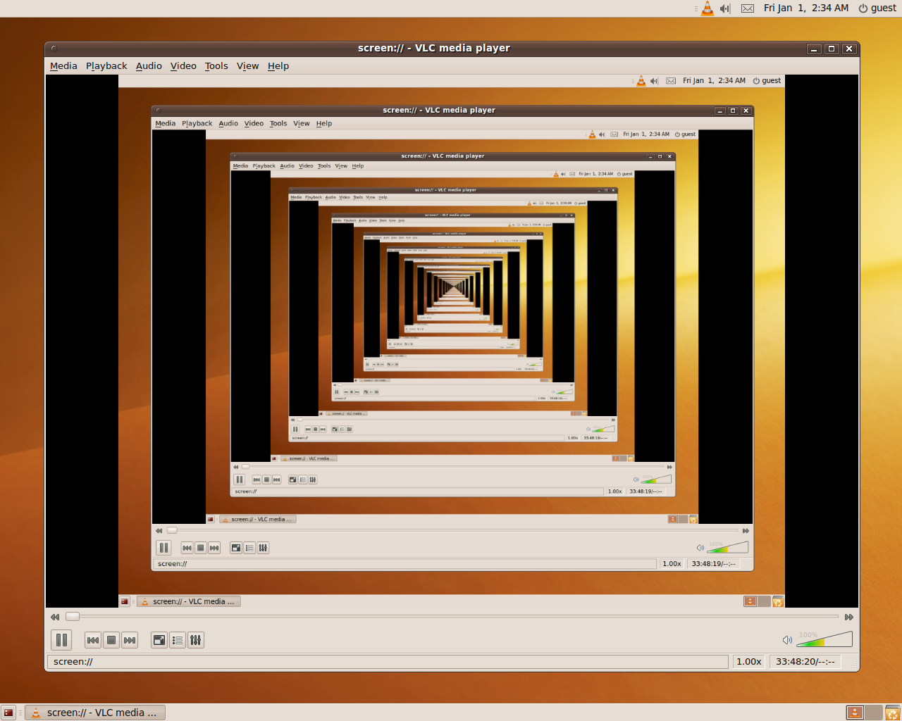
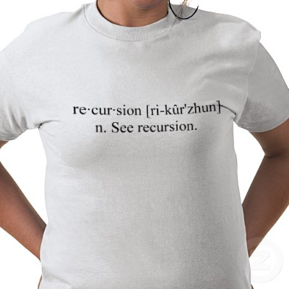

Slide 4
Recursive Thinking
Recursion is a programming technique in which a method can call itself to solve a problem
A recursive definition is one which uses the word or concept being defined in the definition itself
Before applying recursion to programming, it is best to practice thinking recursively

Slide 5
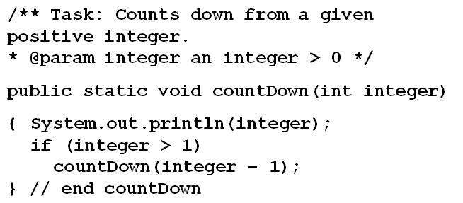
What Is Recursion?
A method that calls itself is a recursive method

Slide 6
What Is Recursion?
Breaks a problem into identical but smaller problems – call with a “smaller” or “simpler” case each time.
Eventually you reach a smallest problem
Answer is trivial (computed directly)
Using simpler solution enables us to solve “larger” more complex problem

Slide 7
Recursive Definitions
Consider the following list of numbers:
24, 88, 40, 37
Such a list can be defined recursively:
A LIST is a: number
or a: number comma LIST
The concept of a LIST is used to define itself
A LIST can be a number, or…
A number followed by a comma followed by a LIST

Slide 8
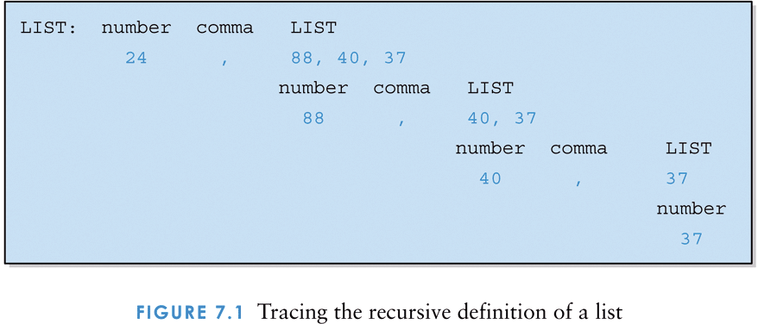
Tracing the recursive definition of a list
Base case?
Recursive case?

Slide 9
Recursive Definitions
Mathematical formulas are often expressed recursively
N!, for any positive integer N, is defined to be the product of all integers between 1 and N inclusive
This definition can be expressed recursively:
1! = 1
N! = N * (N-1)!
A factorial is defined in terms of another factorial until the base case of 1! is reached

Slide 10
Recursion: factorial
So, a function is said to be defined recursively if its definition consists of
♦ An anchor or base case in which the function’s value is defined for one or more values of the parameters
♦ An inductive or recursive step in which the function’s value (or action) for the current parameter values is defined in terms of previously defined function values (or actions) and/or parameter values.
:
int Factorial(int n) { if (n = = 0) return 1; else return n * Factorial(n - 1); }

Slide 11
Recursive Programming
A method in Java can invoke itself; if set up that way, it is called a recursive method
The code of a recursive method must be structured to handle both the base case and the recursive case!
Otherwise…. Infinite recursion occurs!
This manifests itself as… ?

Slide 12
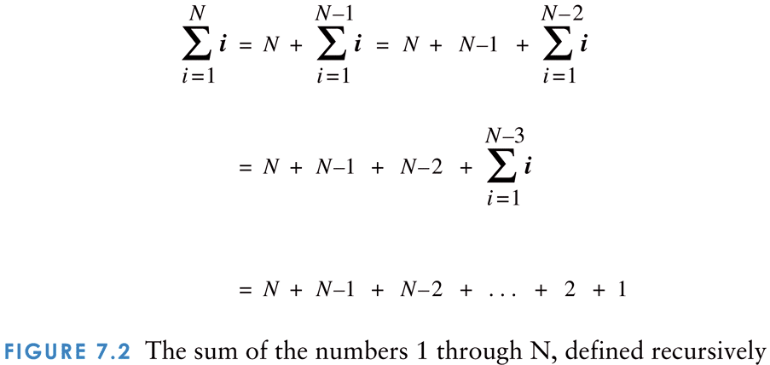
Recursive definition: The sum of the numbers 1 through N

Slide 13
Recursive Programming
Consider the problem of computing the sum of all the numbers between 1 and N, inclusive
If N is 5, the sum is
1 + 2 + 3 + 4 + 5
This problem can be expressed recursively as:
The sum of 1 to N is N plus the sum of 1 to N-1

Slide 14
Recursive Programming
public int sum (int num)
{
int result;
if (num == 1)
result = 1;
else
result = num + sum(num-1);
return result;
}

Slide 15
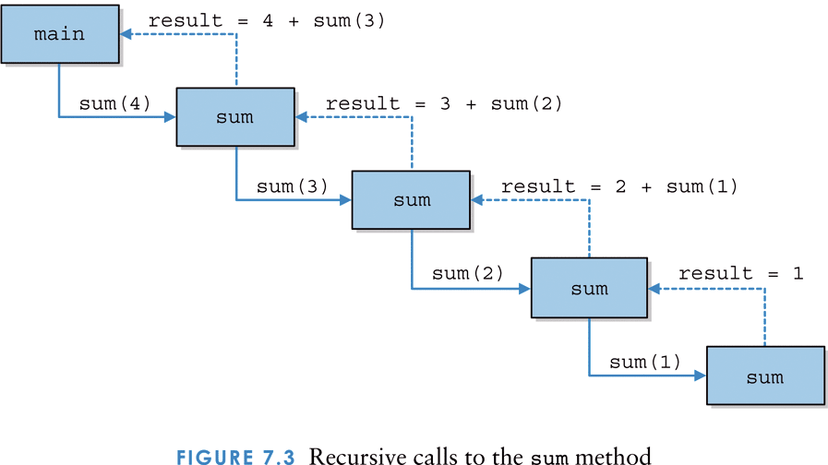
Recursive calls to the sum method A STACK of METHOD calls

Slide 16
Activation Stacks & Recursion
Java keeps track of which methods are executing by using a Program Stack.
The program stack contains Activation Records that contain the method’s:
- Arguments (parameters) – copy by value
- Local variables
that disappear when method ends
- Return address to CALLING method

Slide 17

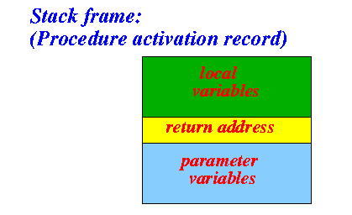
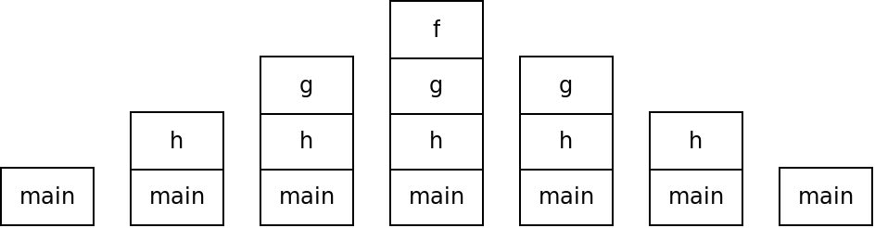
Stack Frame
(Activation Record)
Sequence of Activation Records

Slide 18
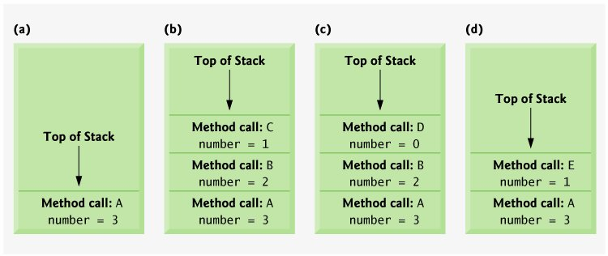
The Stack grows and shrinks as methods are called and exited
( a ) Method A starts.
( b ) Method A calls B. Method B calls C.
( c ) C exits and returns to B. B then calls Method D.
( d ) Method D exits, returns to B. Method B returns to A. Method A calls E.

Slide 19
A broken recursive version of sum(n)
// recursive version of sum with an error:
// computes 1 + 2 … + n
long sum(long n)
{
return n + sum( n – 1);
if (n == 1) return 1;
}

Slide 20
Infinite Recursion
All recursive definitions must have a non-recursive part (base case)
If they don't, there is no way to terminate the recursive path
A definition without a non-recursive part causes infinite recursion
This problem is similar to an infinite loop -- with the definition itself causing the infinite "looping"

Slide 21
Recursion vs. Iteration
Just because we can use recursion to solve a problem, doesn't mean we should !
For instance, we usually would not use recursion to solve the sum of 1 to N
The iterative version is easier to understand (in fact there is a formula that is superior to both recursion and iteration in this case)…
You must be able to determine when recursion is the correct technique to use.

Slide 22
Iterative version of sum(n)
// iterative version of sum:
// computes 1 + 2 … + n
long sum(int n)
{
long answer = 0;
while (n-- > 0) answer = answer + n;
return answer;
}
// Even better, direct calculation:
return (n * (n+1)) / 2;

Slide 23
// fix the bugs and write the code
// Count the number of digits in a positive integer
int F(int n)
{ // iterative, cheaper
int count = 0;
while ( n >= 10)
{
count++;
n /= 10;
}
return count;
}
int F(int n) { // recursive, expensive!
}
Notes:
Solution:
Set count to 1 for iterative version: N=5 should return 1.
int F(int n, int count) { // recursive, expensive! if (n < 10) return 1;
else
return 1+ F(n/10);
}

Slide 24
Iterative power(x, n). Trace 2^3
// computes x to the nth power
long power(int x, int n)
{ long answer =1;
if (n ==0) return answer;
While (n-- > 0) answer = answer * x;
return answer;
}
ANSWER X N // Do recursive version!
1 2 0
2 2 1
4 2 2
8 2 3
Notes:
Long power(int x, int n) { if (n == 0) return 1;
return x * power( x, n-1);

